Slide 1
Angular Material
Getting Started
Lecture 2
By James(Jin) Wang
10/06/2022

Slide 2
Outline
Overview of Tooling
Angular Cli
Angular Material

Slide 3
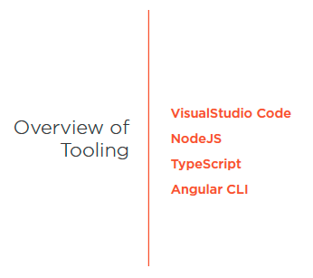
Overview of Tooling
  Overview of Tooling

Slide 4
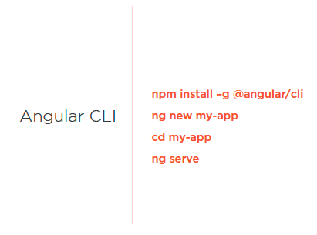
Angular CLi
  Angular CLi

Slide 5
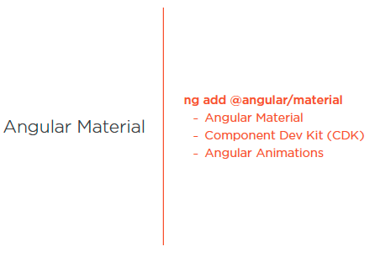
Angular Material
  Angular Material

Slide 6
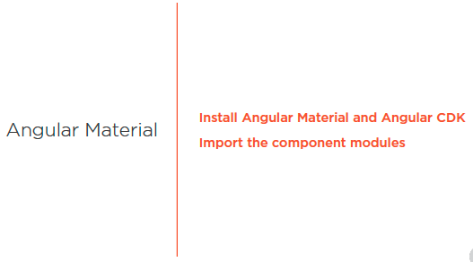
Angular Material
  Angular Material

Slide 7
Angular Material
  Angular Material
  ng add @angular/material
  Demo: add Angular Material

Slide 8
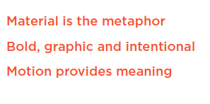
Summary

Slide 9
Assignment

Slide 10
Self Study
  Styling Application with Angular Material
  https://app.pluralsight.com/library/courses/angular-material

